Slide 1
PnP PowerShell: Become a scripting hero
Erwin van Hunen
Lead Architect, Valo
@erwinvanhunen

Slide 2
Notes for the speakers
Hey! Here are some tasks for you
Choose one of the four Title slide templates for your cover slide
Fill in the Session Title and your personal information
Go to View -> Slide Master and update the speaker’s picture with yours
Update the speaker’s picture in the “About me” slide
And provide some useful information about yourself …
Never mind about the “impostor syndrome” ☺
Save the presentation file naming it like
FirstName-LastName-Session-Title.pptx
Record the video of your session (MP4 Full HD 1920x1080)
Name the video file like
FirstName-LastName-Session-Title.mp4
Remember that sessions last 30 minutes (no more, no less ☺!)
Upload your presentation and video
Deadline? August 21st 2020 (please …)
Where? Teams channel dedicated to the PnP Virtual Conference, use the “September-2020-Edition” target folder
Have fun and thank you!

Slide 3
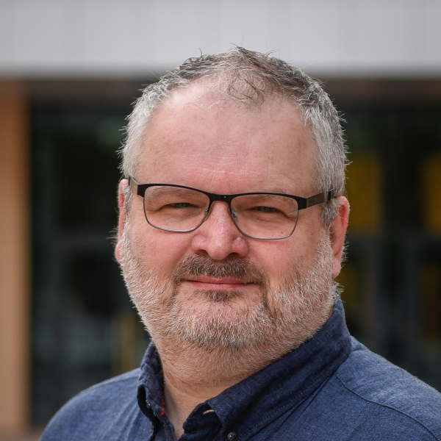
About me
Erwin van Hunen
Lead Architect, Valo Intranet
Called 'The Father of PnP PowerShell' AMONG FRIENDS ;-)
I make music too! https://tinyurl.com/vanhunenmusic
https://www.erwinmcm.com
@erwinvanhunen

Slide 4
History
Created in 2014
Downloaded millions of times
1.1 > billion cmdlets executed per month

Slide 5
Agenda
Getting up and running
Sneak peek of PnP PowerShell Core in an Azure function

Slide 6
Getting up and running

Slide 7
Sneak peek: PnP PowerShell Core

